Slide 1
Mac OS X for the Wary
Surajit A. Bose
Stanford University

Slide 2
About this Presentation

Slide 3
About this Presentation
Intended as an introduction to Mac OS X

Slide 4
About this Presentation
Intended as an introduction to Mac OS X
Not intended as a technical dissection

Slide 5
About this Presentation
Intended as an introduction to Mac OS X
Not intended as a technical dissection
So if you’re the kind who types
awk -F: ‘{print $7}’ /etc/passwd | sort |uniq -c
into a command line just because you get off on login shell stats, you’re in the wrong presentation

Slide 6
About this Presentation
Intended as an introduction to Mac OS X
Not intended as a technical dissection
Aims more toward those who need to support the operating system, but aren’t too familiar with it

Slide 7
About this Presentation
Intended as an introduction to Mac OS X
Not intended as a technical dissection
Aims more toward those who need to support the operating system, but aren’t too familiar with it
Far from comprehensive; your mileage may vary

Slide 8
About Mac OS X

Slide 9
About Mac OS X
New architecture

Slide 10
About Mac OS X
New architecture
New folder hierarchy

Slide 11
About Mac OS X
New architecture
New folder hierarchy
Networking Mac OS X

Slide 12
Architecture of Mac OS X

Slide 13
Architecture of Mac OS X
Hardware

Slide 14
Architecture of Mac OS X
Hardware
• Requires G3 or better processor

Slide 15
Architecture of Mac OS X
Hardware
• Requires G3 or better processor • No support for serial ports

Slide 16
Architecture of Mac OS X
Darwin
Hardware

Slide 17
Architecture of Mac OS X
Darwin
Hardware
• Open source kernel

Slide 18
Architecture of Mac OS X
Darwin
Hardware
• Open source kernel • http://developer.apple.com/darwin/

Slide 19
Architecture of Mac OS X
Mach 3.0 | FreeBSD 3.2
Hardware

Slide 20
Architecture of Mac OS X
Mach 3.0 | FreeBSD 3.2
Hardware
Mach microkernel handles:

Slide 21
Architecture of Mac OS X
Mach 3.0 | FreeBSD 3.2
Hardware
Mach microkernel handles: • Memory

Slide 22
Architecture of Mac OS X
Mach 3.0 | FreeBSD 3.2
Hardware
Mach microkernel handles: • Memory • Interprocess communication

Slide 23
Architecture of Mac OS X
Mach 3.0 | FreeBSD 3.2
Hardware
BSD handles:

Slide 24
Architecture of Mac OS X
Mach 3.0 | FreeBSD 3.2
Hardware
BSD handles: • File systems (UFS, HFS+, ISO 9660)

Slide 25
Architecture of Mac OS X
Mach 3.0 | FreeBSD 3.2
Hardware
BSD handles: • File systems (UFS, HFS+, ISO 9660) • POSIX APIs

Slide 26
Architecture of Mac OS X
Mach 3.0 | FreeBSD 3.2
Hardware
BSD handles: • File systems (UFS, HFS+, ISO 9660) • POSIX APIs • Networking

Slide 27
Architecture of Mac OS X
Mach 3.0 | FreeBSD 3.2
Hardware
BSD handles: • File systems (UFS, HFS+, ISO 9660) • POSIX APIs • Networking • Processes

Slide 28
Architecture of Mac OS X
Graphics
Mach 3.0 | FreeBSD 3.2
Hardware

Slide 29
Architecture of Mac OS X
Quartz | OpenGL |  | QuickTime
Mach |  | BSD
Hardware

Slide 30
Architecture of Mac OS X
Quartz | OpenGL |  | QuickTime
Mach |  | BSD
Hardware
Quartz provides:

Slide 31
Architecture of Mac OS X
Quartz | OpenGL |  | QuickTime
Mach |  | BSD
Hardware
Quartz provides: • 2D graphics support

Slide 32
Architecture of Mac OS X
Quartz | OpenGL |  | QuickTime
Mach |  | BSD
Hardware
Quartz provides: • 2D graphics support • PDF rendering!

Slide 33
Architecture of Mac OS X
Quartz | OpenGL |  | QuickTime
Mach |  | BSD
Hardware
OpenGL provides industry-standard 3D graphics support

Slide 34
Architecture of Mac OS X
Quartz | OpenGL |  | QuickTime
Mach |  | BSD
Hardware
QuickTime provides multimedia support

Slide 35
Architecture of Mac OS X
Frameworks and Environments
Quartz | OpenGL |  | QuickTime
Mach |  | BSD
Hardware

Slide 36
Architecture of Mac OS X
Classic | Carbon |  | Cocoa
Quartz | OpenGL |  | QuickTime
Mach |  | BSD
Hardware

Slide 37
Architecture of Mac OS X
Classic | Carbon |  | Cocoa
Quartz | OpenGL |  | QuickTime
Mach |  | BSD
Hardware
• Classic is an application within OS X
Notes:
• Needs a recognizable Mac OS 9.x system folder to operate

Slide 38
Architecture of Mac OS X
Classic | Carbon |  | Cocoa
Quartz | OpenGL |  | QuickTime
Mach |  | BSD
Hardware
• Classic is an application within OS X • Carbon libraries allow older apps to be recompiled to be OS X native

Slide 39
Architecture of Mac OS X
Classic | Carbon |  | Cocoa
Quartz | OpenGL |  | QuickTime
Mach |  | BSD
Hardware
• Classic is an application within OS X • Carbon libraries allow older apps to be recompiled to be OS X native • Cocoa is a new object-oriented framework for developing applications

Slide 40
Architecture of Mac OS X
Interface
Classic | Carbon |  | Cocoa
Quartz | OpenGL |  | QuickTime
Mach |  | BSD
Hardware

Slide 41
Architecture of Mac OS X
Interface
Classic | Carbon |  | Cocoa
Quartz | OpenGL |  | QuickTime
Mach |  | BSD
Hardware
• Very lickable Aqua layer

Slide 42
Architecture of Mac OS X
Interface
Classic | Carbon |  | Cocoa
Quartz | OpenGL |  | QuickTime
Mach |  | BSD
Hardware
• Very lickable Aqua layer • Provides a user-friendly ‘skin’ to UNIX

Slide 43
Architecture of Mac OS X
Scripting and Messaging
Interface
Classic | Carbon |  | Cocoa
Quartz | OpenGL |  | QuickTime
Mach |  | BSD
Hardware

Slide 44
Architecture of Mac OS X
AppleScript | Terminal |  | Services
Interface
Classic | Carbon |  | Cocoa
Quartz | OpenGL |  | QuickTime
Mach |  | BSD
Hardware

Slide 45
Architecture of Mac OS X
AppleScript | Terminal |  | Services
Interface
Classic | Carbon |  | Cocoa
Quartz | OpenGL |  | QuickTime
Mach |  | BSD
Hardware
AppleScript provides the ability to automate routines

Slide 46
Architecture of Mac OS X
AppleScript | Terminal |  | Services
Interface
Classic | Carbon |  | Cocoa
Quartz | OpenGL |  | QuickTime
Mach |  | BSD
Hardware
Terminal provides command-line access

Slide 47
Architecture of Mac OS X
AppleScript | Terminal |  | Services
Interface
Classic | Carbon |  | Cocoa
Quartz | OpenGL |  | QuickTime
Mach |  | BSD
Hardware
Services provide built-in spell checking, e-mail integration, etc.

Slide 48
Architecture of Mac OS X
Applications
AppleScript | Terminal |  | Services
Interface
Classic | Carbon |  | Cocoa
Quartz | OpenGL |  | QuickTime
Mach |  | BSD
Hardware

Slide 49
Typical Directory Structure

Slide 50
Typical Directory Structure
Far more rigid than previous versions of the OS

Slide 51
Typical Directory Structure
Far more rigid than previous versions of the OS
True multi-user environment with all the complexity of UNIX permissions

Slide 52
Typical Directory Structure
Far more rigid than previous versions of the OS
True multi-user environment with all the complexity of UNIX permissions
Some files and folders are owned by the system, others by users with accounts on the computer

Slide 53
Typical Directory Structure
Far more rigid than previous versions of the OS
True multi-user environment with all the complexity of UNIX permissions
Some files and folders are owned by the system, others by users with accounts on the computer
Some users are administrators, others just ordinary schlubs

Slide 54
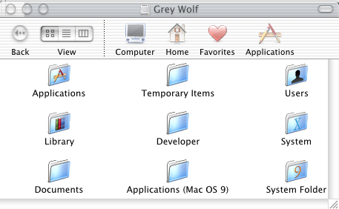
Typical Directory Structure
Standard set of folders at the root level of the drive

Slide 55
Typical Directory Structure
Standard set of folders at the root level of the drive
  System: No user serviceable parts inside

Slide 56
Typical Directory Structure
Standard set of folders at the root level of the drive
  System: No user serviceable parts inside
  Library: Contains preferences, fonts, support files, etc. that may be used by everyone who has an account on the computer

Slide 57
Typical Directory Structure
Standard set of folders at the root level of the drive
  System: No user serviceable parts inside
  Library: Contains preferences, fonts, support files, etc. that may be used by everyone who has an account on the computer
  Applications

Slide 58
Typical Directory Structure
Standard set of folders at the root level of the drive
  System: No user serviceable parts inside
  Library: Contains preferences, fonts, support files, etc. that may be used by everyone who has an account on the computer
  Applications
  Users: Has one folder (the ‘home directory’) for each person with an account on the computer

Slide 59
Typical Directory Structure
Standard set of folders at the root level of the drive
Partially replicated at other levels

Slide 60
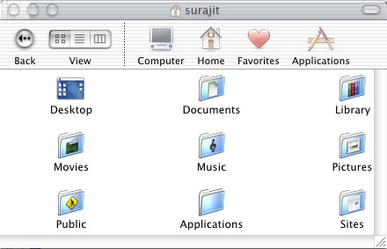
Typical Directory Structure
Standard set of folders at the root level of the drive
Partially replicated at other levels
  Each user’s home directory also has a Library folder and an Applications folder

Slide 61
Typical Directory Structure
Standard set of folders at the root level of the drive
Partially replicated at other levels
  Each user’s home directory also has a Library folder and an Applications folder
  These store fonts, preferences, and applications specific to that user

Slide 62
Typical Directory Structure
Standard set of folders at the root level of the drive
Partially replicated at other levels
  Each user’s home directory also has a Library folder and an Applications folder
  These store fonts, preferences, and applications specific to that user
  Other users do not have access to these

Slide 63
Typical Directory Structure
Standard set of folders at the root level of the drive
Partially replicated at other levels
OS searches through these in a particular order

Slide 64
Typical Directory Structure
Standard set of folders at the root level of the drive
Partially replicated at other levels
OS searches through these in a particular order
E.g. if a document in a user’s home directory uses a particular font, this is the search order:

Slide 65
Typical Directory Structure
User’s ~/Library/Fonts folder

Slide 66
Typical Directory Structure
User’s ~/Library/Fonts folder
Application created support folder in the Library folder

Slide 67
Typical Directory Structure
User’s ~/Library/Fonts folder
Application created support folder in the Library folder
/Library/Fonts folder at the root level of the hard drive

Slide 68
Typical Directory Structure
User’s ~/Library/Fonts folder
Application created support folder in the Library folder
/Library/Fonts folder at the root level of the hard drive
/System/Library/Fonts folder, which contains fonts used by the OS

Slide 69
Typical Directory Structure
User’s ~/Library/Fonts folder
Application created support folder in the Library folder
/Library/Fonts folder at the root level of the hard drive
/System/Library/Fonts folder, which contains fonts used by the OS
Mac OS 9.x Fonts folder

Slide 70
Typical Directory Structure
User’s ~/Library/Fonts folder
Application created support folder in the Library folder
/Library/Fonts folder at the root level of the hard drive
/System/Library/Fonts folder, which contains fonts used by the OS
Mac OS 9.x Fonts folder
A network Fonts folder

Slide 71
Networking Mac OS X

Slide 72
Networking Mac OS X
Getting the sucka online

Slide 73
Networking Mac OS X
Getting the sucka online
File server protocols supported

Slide 74
Networking Mac OS X
Getting the sucka online
File server protocols supported
Integrating OS X into an existing domain

Slide 75
Networking Mac OS X
Getting the sucka online
File server protocols supported
Integrating OS X into an existing domain
Running a classroom or lab of Mac OS X clients

Slide 76
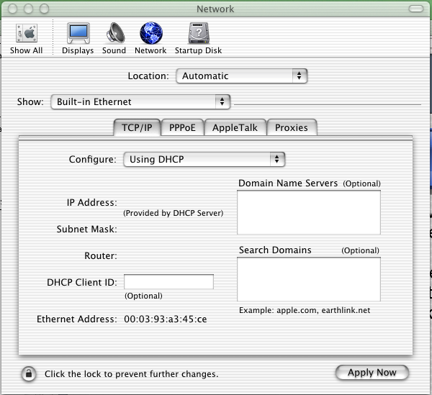
Getting an OS X client online
Configurations live in the Network pane of the System Preferences panel, accessible from the Apple menu.

Slide 77
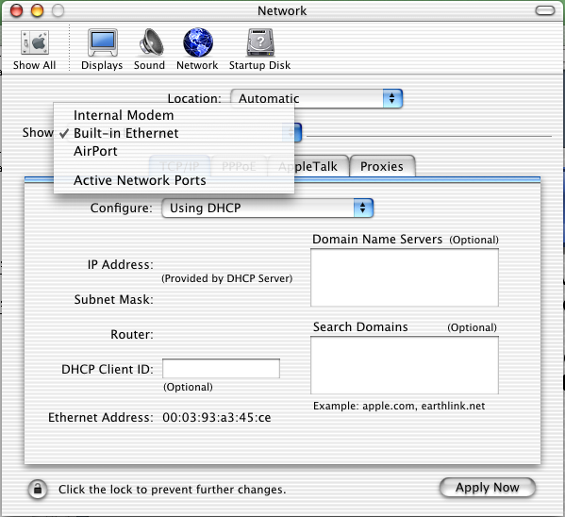
Getting an OS X client online
Can switch between different interfaces in the pop-up menu

Slide 78
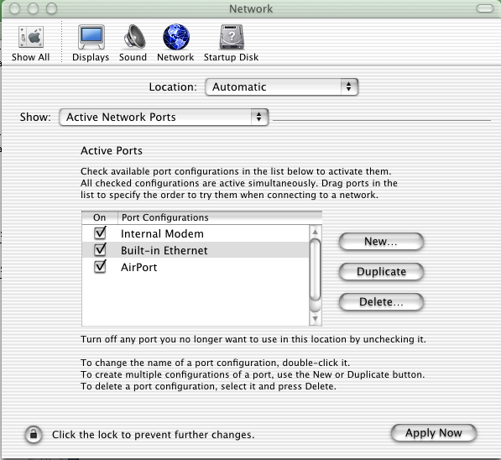
Getting an OS X client online
Via the ‘Active Network Ports’ option, can turn ports on and off

Slide 79
Getting an OS X client online
Via the ‘Active Network Ports’ option, can turn ports on and off
Can also specify a hierarchy of ports

Slide 80
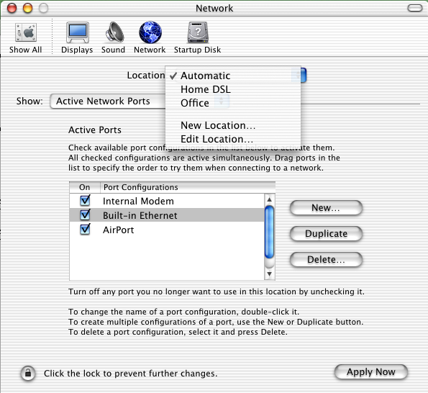
Getting an OS X client online
Via the ‘Location’ pop-up menu, can create different configurations for different locations

Slide 81
File Server Protocols

Slide 82
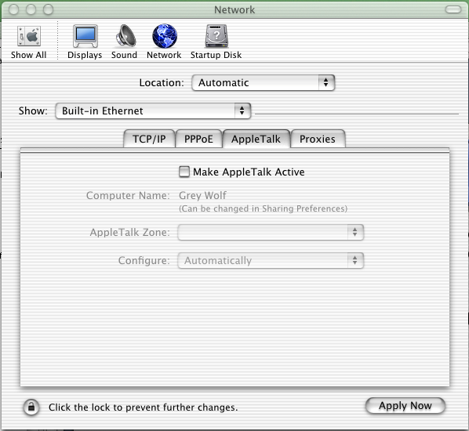
File Server Protocols
AppleTalk is off by default (very interesting)

Slide 83
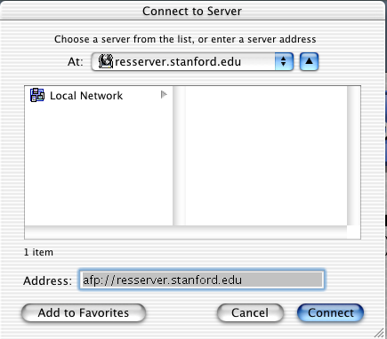
File Server Protocols
From the ‘Connect to Server’ option of the ‘Go’ menu in the Finder, Mac OS X clients can connect to AFP, NFS, SMB, and Samba servers

Slide 84
OS X’s Directory Services

Slide 85
OS X’s Directory Services
By default, OS X is set up to integrate to a NetInfo domain (inherited from NeXT)

Slide 86
OS X’s Directory Services
By default, OS X is set up to integrate to a NetInfo domain (inherited from NeXT)
But it has built-in LDAP integration too

Slide 87
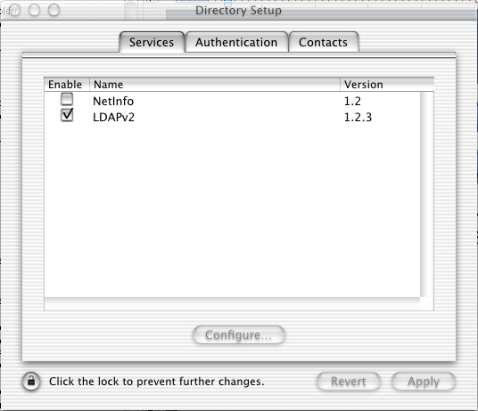
OS X’s Directory Services
By default, OS X is set up to integrate to a NetInfo domain (inherited from NeXT)
But it has built-in LDAP integration too
Can be configured using the Directory Setup utility in /Applications/Utilities

Slide 88
Running a Mac OS X Lab

Slide 89
Running a Mac OS X Lab
The indispensable resource: http://www.macosxlabs.org/

Slide 90
Running a Mac OS X Lab
The indispensable resource: http://www.macosxlabs.org/
A consortium of 25 colleges and universities working toward deploying Mac OS X in labs, clusters, and classrooms

Slide 91
Running a Mac OS X Lab
The indispensable resource: http://www.macosxlabs.org/
A consortium of 25 colleges and universities working toward deploying Mac OS X in labs, clusters, and classrooms
Very thorough listing of issues, processes, and resources

Slide 92
Running a Mac OS X Lab
The indispensable resource: http://www.macosxlabs.org/
A consortium of 25 colleges and universities working toward deploying Mac OS X in labs, clusters, and classrooms
Very thorough listing of issues, processes, and resources
Some other resources:

Slide 93
Running a Mac OS X Lab
Carbon Copy Cloner: http://software.bombich.com/ccc.html

Slide 94
Running a Mac OS X Lab
Carbon Copy Cloner: http://software.bombich.com/ccc.html
Apple Software Restore for Mac OS X: macosxlabs.org/asr_for_osx/asr_for_osx.html

Slide 95
Running a Mac OS X Lab
Carbon Copy Cloner: http://software.bombich.com/ccc.html
Apple Software Restore for Mac OS X: macosxlabs.org/asr_for_osx/asr_for_osx.html
Rsync: macosxlabs.org/rsyncx/rsyncx.html

Slide 96
Running a Mac OS X Lab
Carbon Copy Cloner: http://software.bombich.com/ccc.html
Apple Software Restore for Mac OS X: macosxlabs.org/asr_for_osx/asr_for_osx.html
Rsync: macosxlabs.org/rsyncx/rsyncx.html
KeyServer: http://sassafras.com/docs/appendxd.html#Heading5

Slide 97
Conclusion

Slide 98
Conclusion
Mac OS X offers tremendous advantages

Slide 99
Conclusion
Mac OS X offers tremendous advantages
  Stability (crash-free)

Slide 100
Conclusion
Mac OS X offers tremendous advantages
  Stability (crash-free)
  Many easy-to-use tools to configure the UNIX underpinnings

Slide 101
Conclusion
Mac OS X offers tremendous advantages
  Stability (crash-free)
  Many easy-to-use tools to configure the UNIX underpinnings
  Integrates well with existing infrastructure

Slide 102
Conclusion
Mac OS X offers tremendous advantages
There are also challenges (far from insurmountable)

Slide 103
Conclusion
Mac OS X offers tremendous advantages
There are also challenges (far from insurmountable)
  Novelty

Slide 104
Conclusion
Mac OS X offers tremendous advantages
There are also challenges (far from insurmountable)
  Novelty
  Security

Slide 105
Conclusion
Mac OS X offers tremendous advantages
There are also challenges (far from insurmountable)
  Novelty
  Security
  Software availability

Slide 106
Conclusion
Mac OS X offers tremendous advantages
There are also challenges (far from insurmountable)
It’s great fun to work with, and very rewarding

Slide 107
Conclusion
Mac OS X offers tremendous advantages
There are also challenges (far from insurmountable)
It’s great fun to work with, and very rewarding
So … go for it!

Slide 108
Questions?

Slide 109
Thanks!
Surajit A. Bose
Meyer Library, Room 240
560 Escondido Mall
Stanford, CA 94025
surajit@stanford.edu

